Slide 1
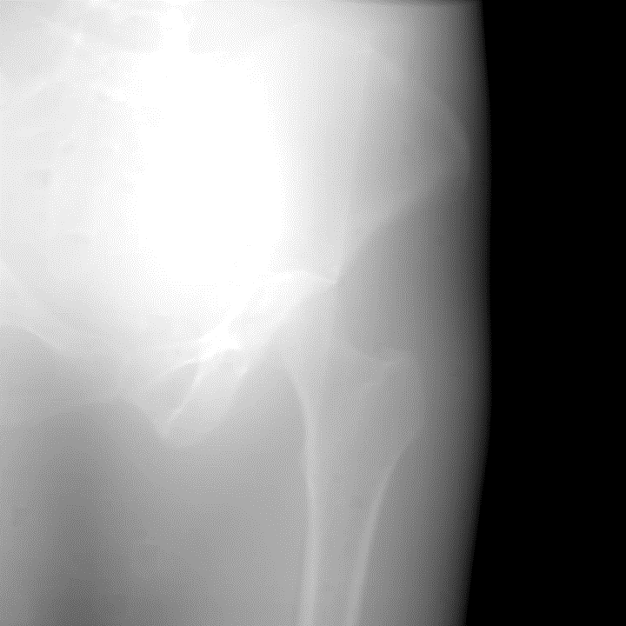
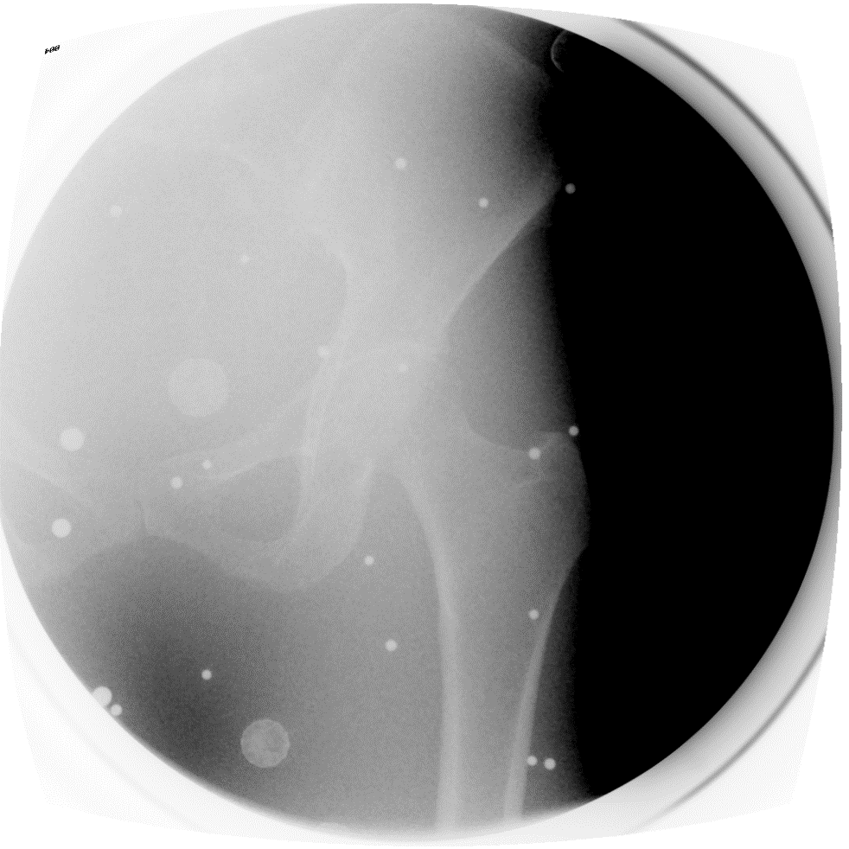
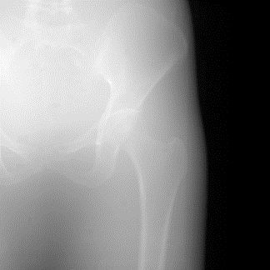

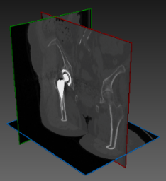
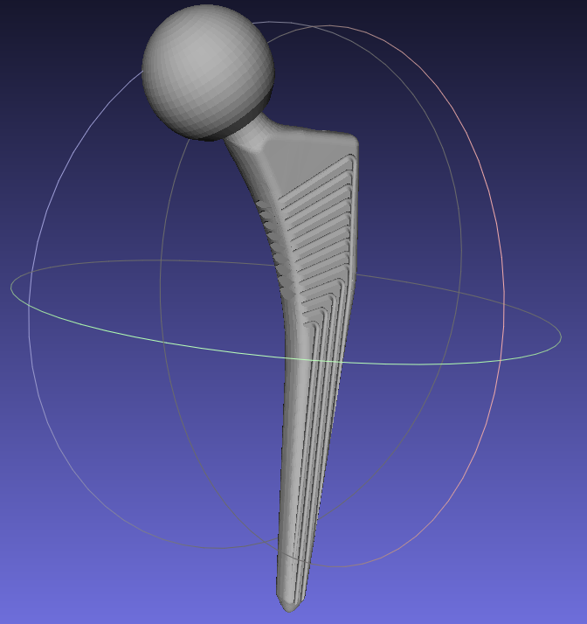
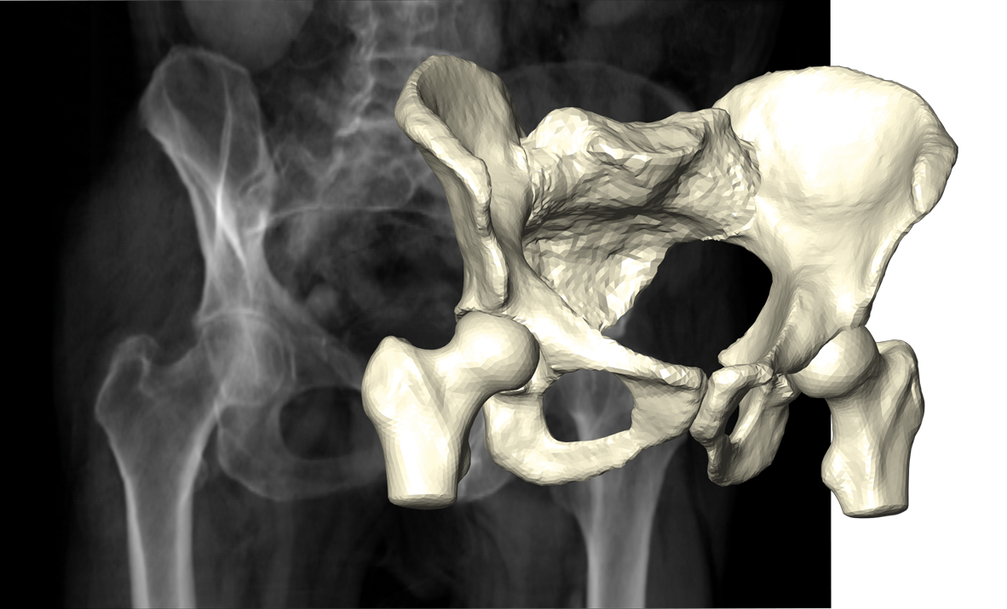
2D-3D registration
Acquired
2D image
Metric
Optimizer
Solution
3D pose
Simulated
2D image
3D model
Projector
3D pose
Notes:
The process of finding the 3D position of a target object (as of the native hip joint in the upper picture and of the prosthetic hip joint in the lower picture), is called 2D-3D registration. Here you are seeing a live demo of the registration process. Behind it we have a 3D model that is projected into a 2D image at a guessed 3D pose. The simulated 2D image is compared to the given real 2D image according to a predefined similarity measure. An optimizer reads the current similarity measure, and updates the guessed 3D pose iteratively until the best similarity is achieved between the simulated and the real image. The final position corresponding to the highest similarity is the final solution.

